Slide 1
Lecture-3 Sequential Circuit Design Shift Registers

Slide 2
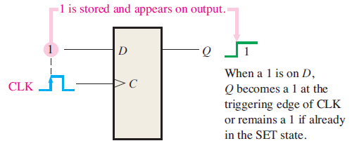
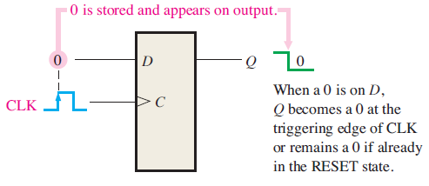
Shift Registers
Shift register is a digital circuit with two basic functions; data storage and data movement.
Shift registers contains different arrangements of flip-flops.
Each flip-flop in a shift register represents one bit of storage capacity.
The number of flip-flops in a register determines its storage capacity.
The shift operation of a register allows the movement of data from one stage to another stage or into or out of the register.
Concept of storing a 1
Concept of storing a 0

Slide 3
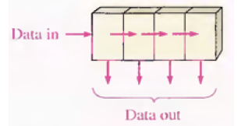
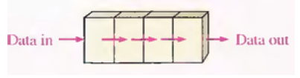
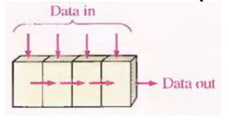
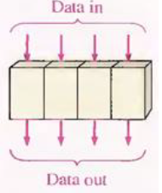
Shift Registers
The are four types of shift register based on their movement:
Serial In Parallel Out (SIPO)
Serial In Serial Out (SISO)
Parallel In Serial Out (PISO)
Parallel In Parallel Out (PIPO)

Slide 4
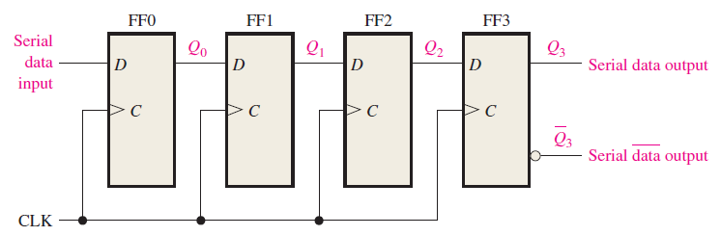
Serial In/ Serial Out Shift Registers
The serial in/serial out shift registers accepts data serial, that is one bit at a time.
It produces the stored information in its output also in serial form
An N-bit flip-flop will take N clock pulses to store N-bit data completely.

Slide 5
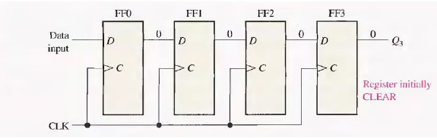
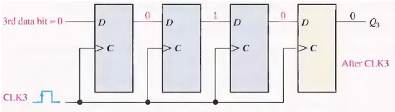
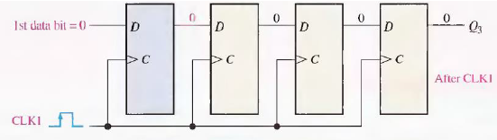
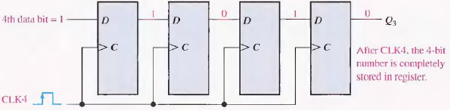
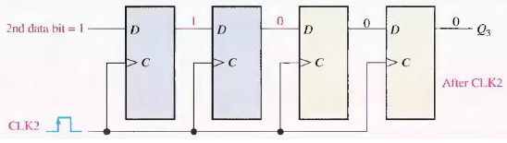
Serial In/ Serial Out Shift Registers
Four bits (1010) being entered serially into the shift register:
Initial State
State after Clock Pulse 3
State after Clock Pulse 1
State after Clock Pulse 4
State after Clock Pulse 2

Slide 6
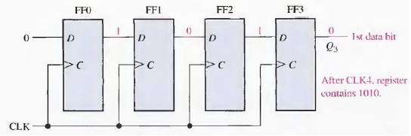
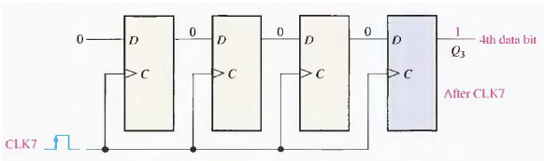
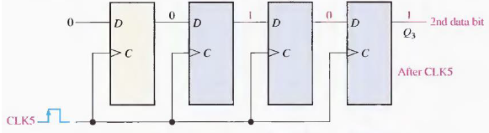
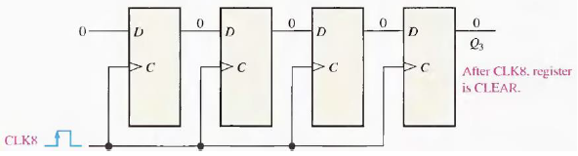
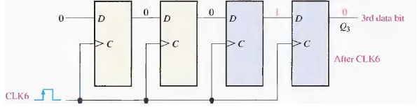
Serial In/ Serial Out Shift Registers
Four bits (1010) being serially shifted out of the register and replaced by zeros:
State after Clock Pulse 4
State after clock pulse 7
State after clock pulse 5
State after clock pulse 8
State after clock pulse 6

Slide 7
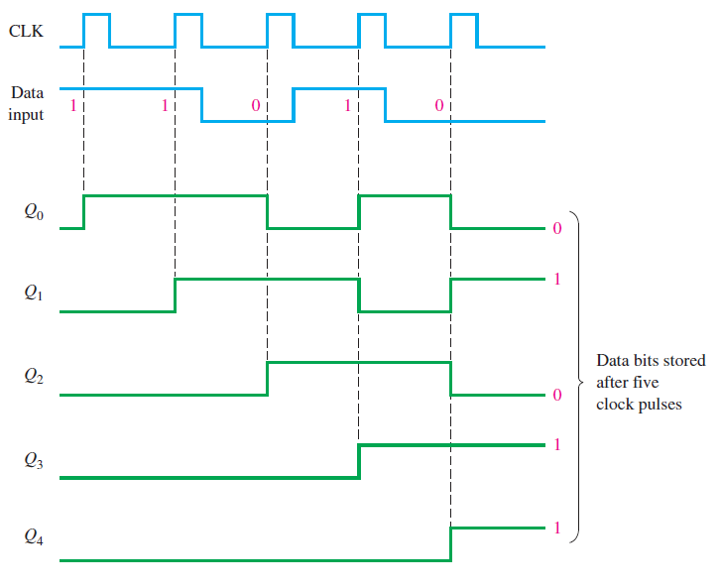
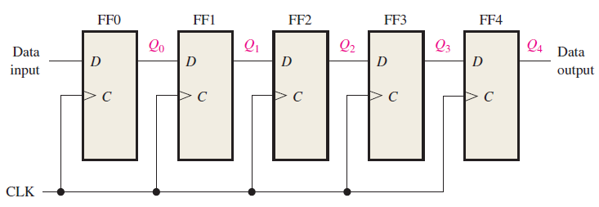
Serial In/ Serial Out Shift Registers

Slide 8
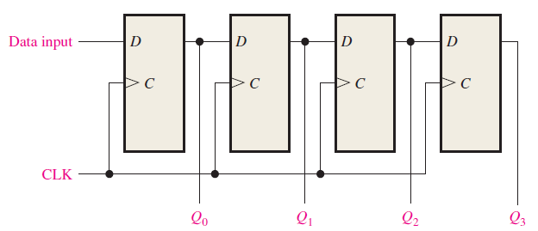
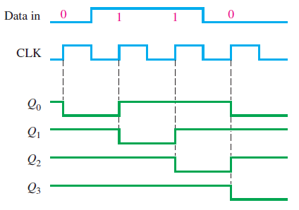
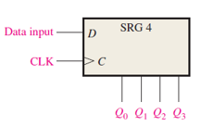
Serial In/ Parallel Out Shift Registers

Slide 9
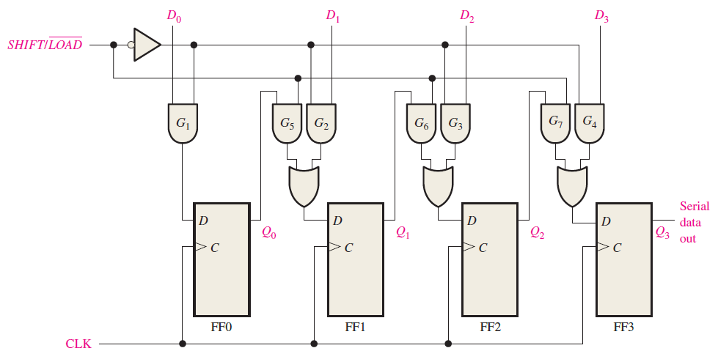

Parallel In/ Serial Out Shift Registers
$Shift/\overline{LOAD}$=0, Load line gets activated
$Shift/\overline{LOAD}$=1, Shift line gets activated

Slide 10
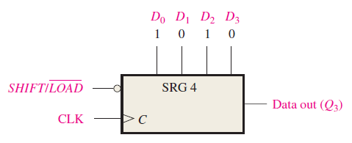
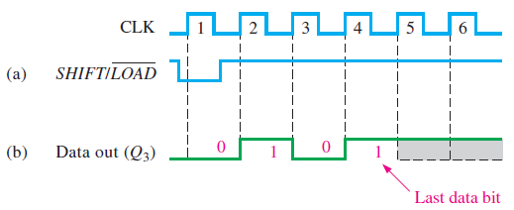
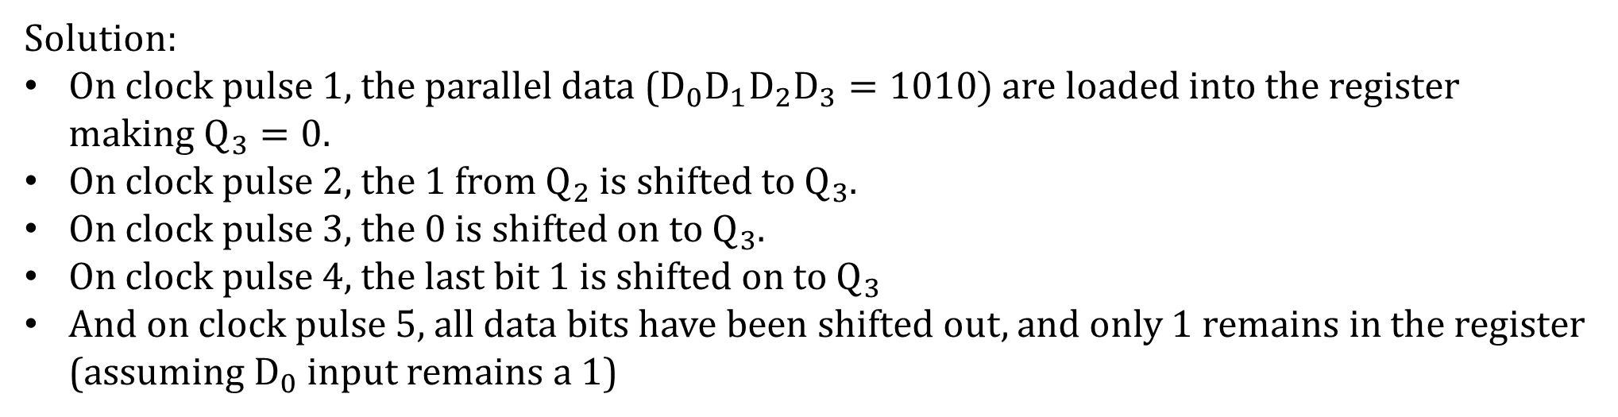
Parallel In/ Serial Out Shift Registers
Show the data-output waveform for a 4-bit register with parallel input data and the clock and SHIFT/$\overline{LOAD}$ waveform.
Solution:
On clock pulse 1, the parallel data ($D_{0}D_{1}D_{2}D_{3}=1010)$ are loaded into the register making $Q_{3}=0$.
On clock pulse 2, the 1 from $Q_{2}$ is shifted to $Q_{3}$.
On clock pulse 3, the 0 is shifted on to $Q_{3}$.
On clock pulse 4, the last bit 1 is shifted on to $Q_{3}$
And on clock pulse 5, all data bits have been shifted out, and only 1 remains in the register (assuming $D_{0}$ input remains a 1)

Slide 11
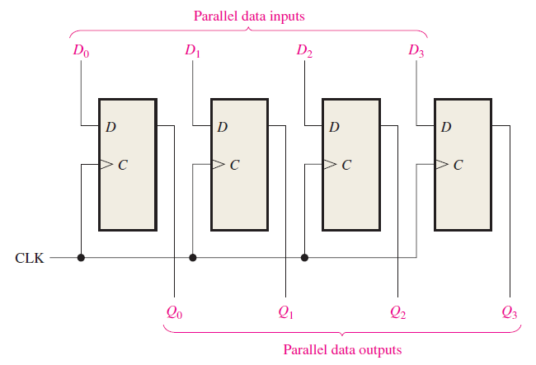
Parallel In/ Parallel Out Shift Registers

Slide 12
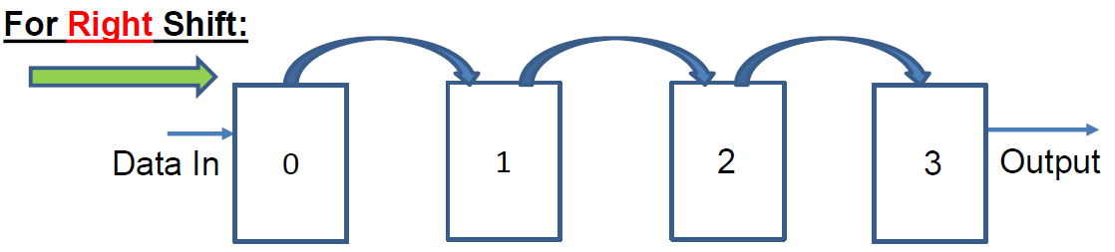
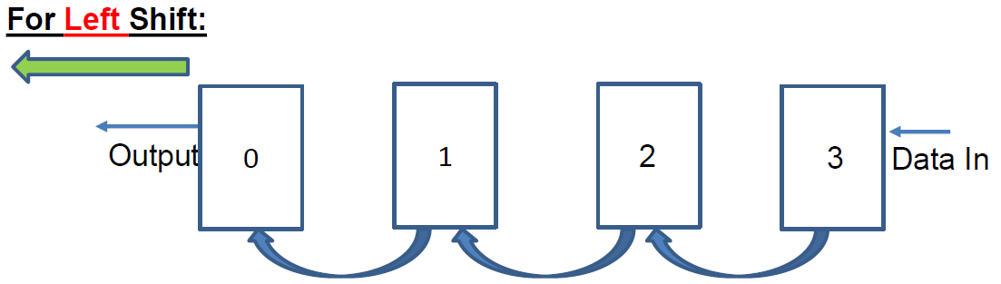
Right Left Shift Operation of SISO Shift Registers

Slide 13
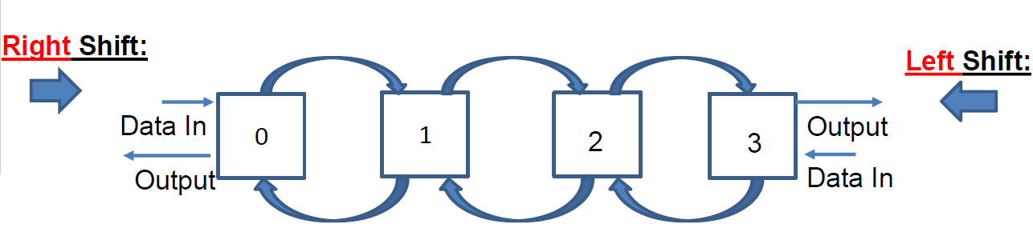
Bidirectional Shift Registers
A bidirectional shift register is one in which data can be shifted either left or right.
It can be implemented using gating logic.
This is done with the help of a control input.

Slide 14
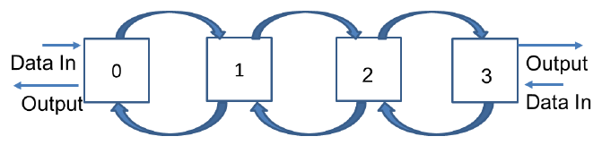
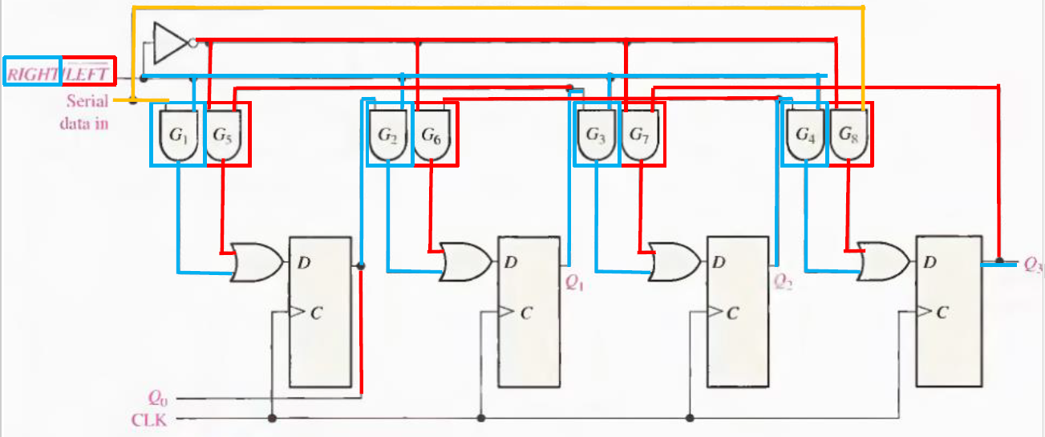
Bidirectional Shift Registers

Slide 15
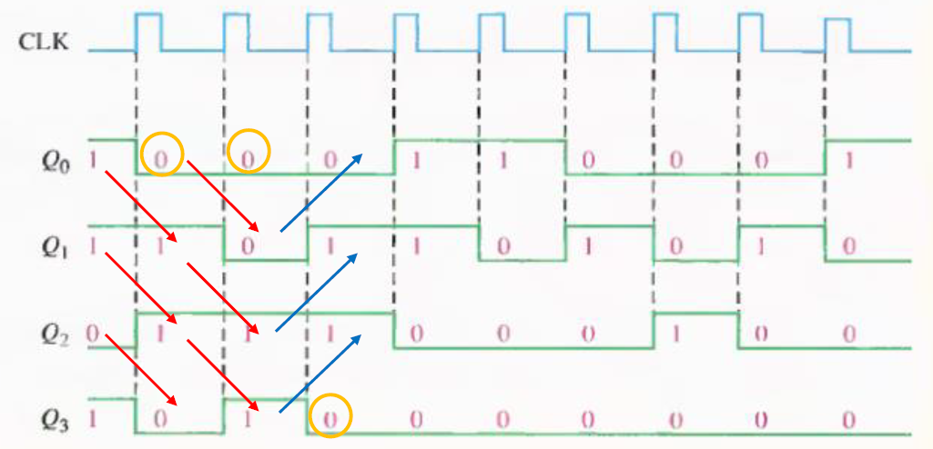
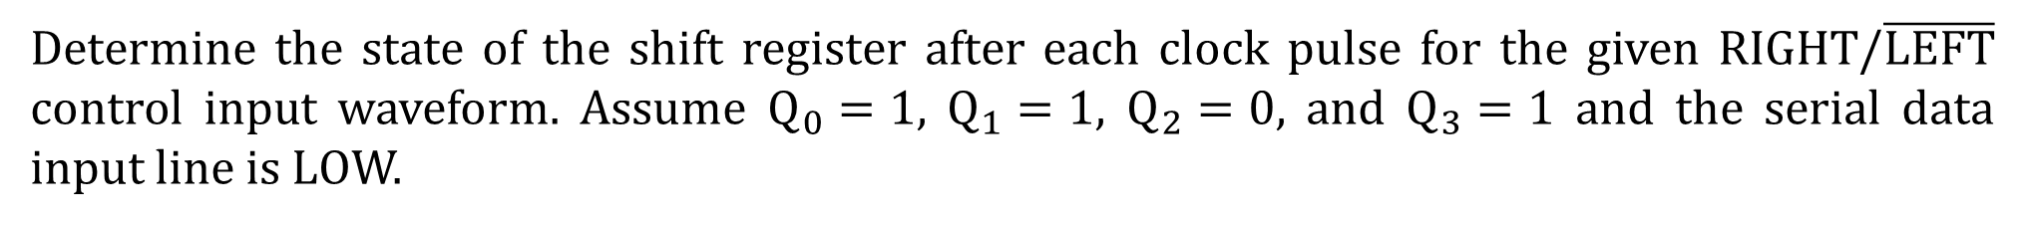
Bidirectional Shift Registers
Determine the state of the shift register after each clock pulse for the given RIGHT/$\overline{LEFT}$ control input waveform. Assume $Q_{0}=1$, $Q_{1}=1$, $Q_{2}=0$, and $Q_{3}=1$ and the serial data input line is LOW.

Slide 16
Shift Register Counters
A shift register counter is basically a shift register with the serial output connected back to the serial input to produce a special sequence. These devices are often classified as counters because they exhibit a specified sequence of states.
Johnson Counters
In a Johnson counter, the complement of the output of the last flip-flop is connected back to the D input of the first flip-flop.
This feedback produces a characteristic sequence of states.
A Johnson counter has 2N states, if there are N flip-flops.
That is a 4-bit sequence has 8 states and a 5-bit sequence has a total of 10 states.

Slide 17
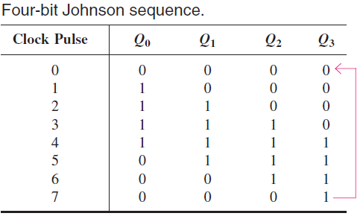
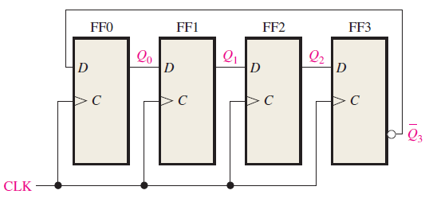
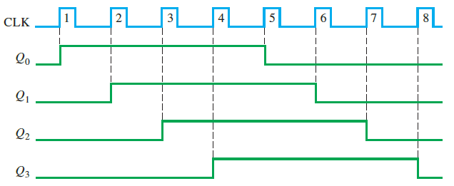
Johnson Counters

Slide 18
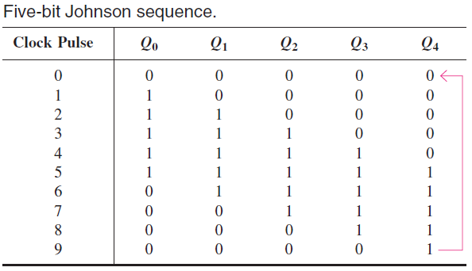
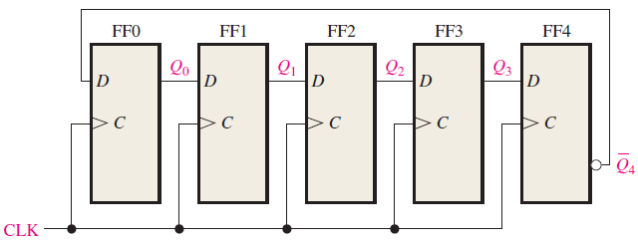
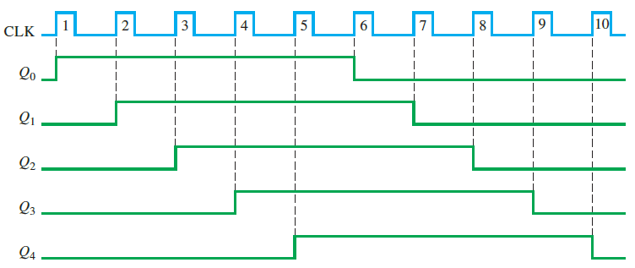
Johnson Counters

Slide 19
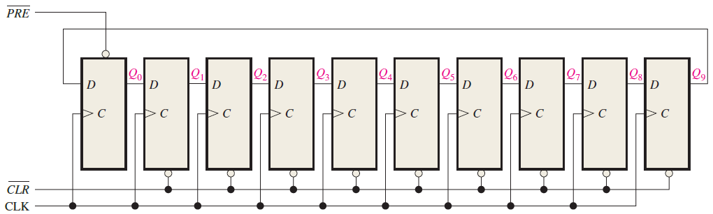
Ring Counters
The ring counter uses one flip-flop for one state in its sequence.
It has an advantage that decoding gates are not required.
In case of a 10-bit ring counter, there is an unique output for each decimal digit.

Slide 20
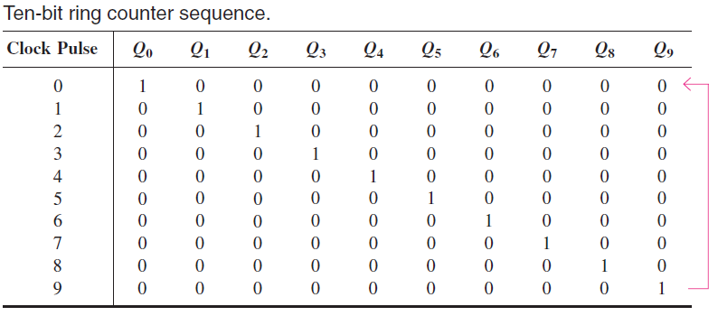
Ring Counters

Slide 21
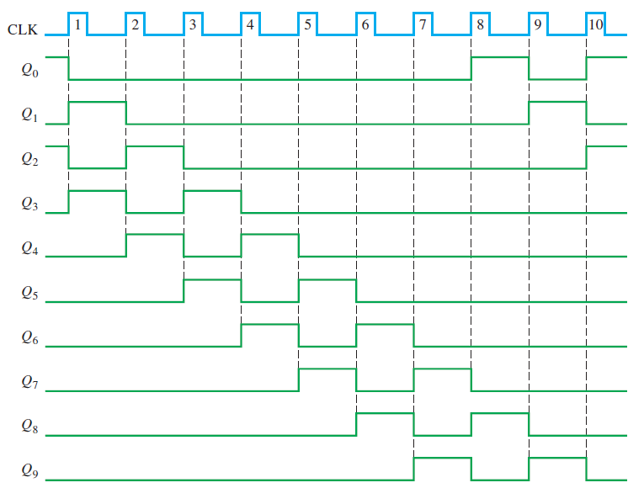
Ring Counters
If a 10-bit ring counter has an initial state of 1010000000, determine the waveform for each of the Q outputs.

Slide 22
References
Thomas L. Floyd, “Digital Fundamentals” 11th edition, Prentice Hall – Pearson Education.
Thank You

